Slide 1
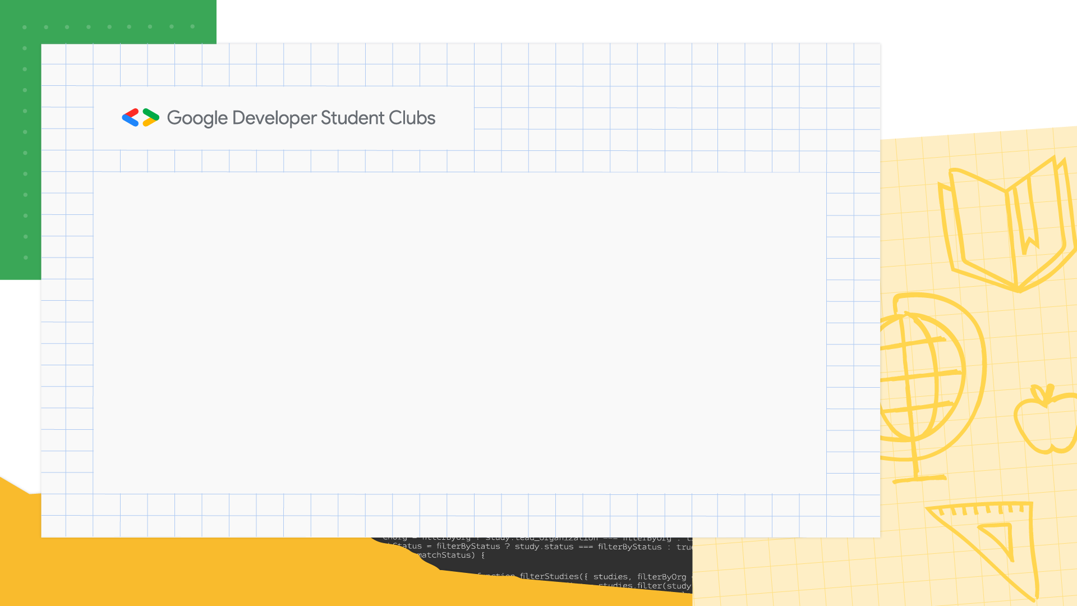











University of Engineering & Technology, Lahore
Google Developers Student Clubs
@dscuet
@dscuet

Slide 2
















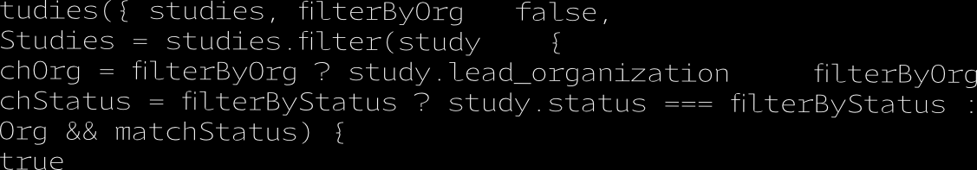

Hello Everyone !
I am Muhammad Abdullah GDSC lead for year 2023-2024 and I welcome you all here .

Slide 3
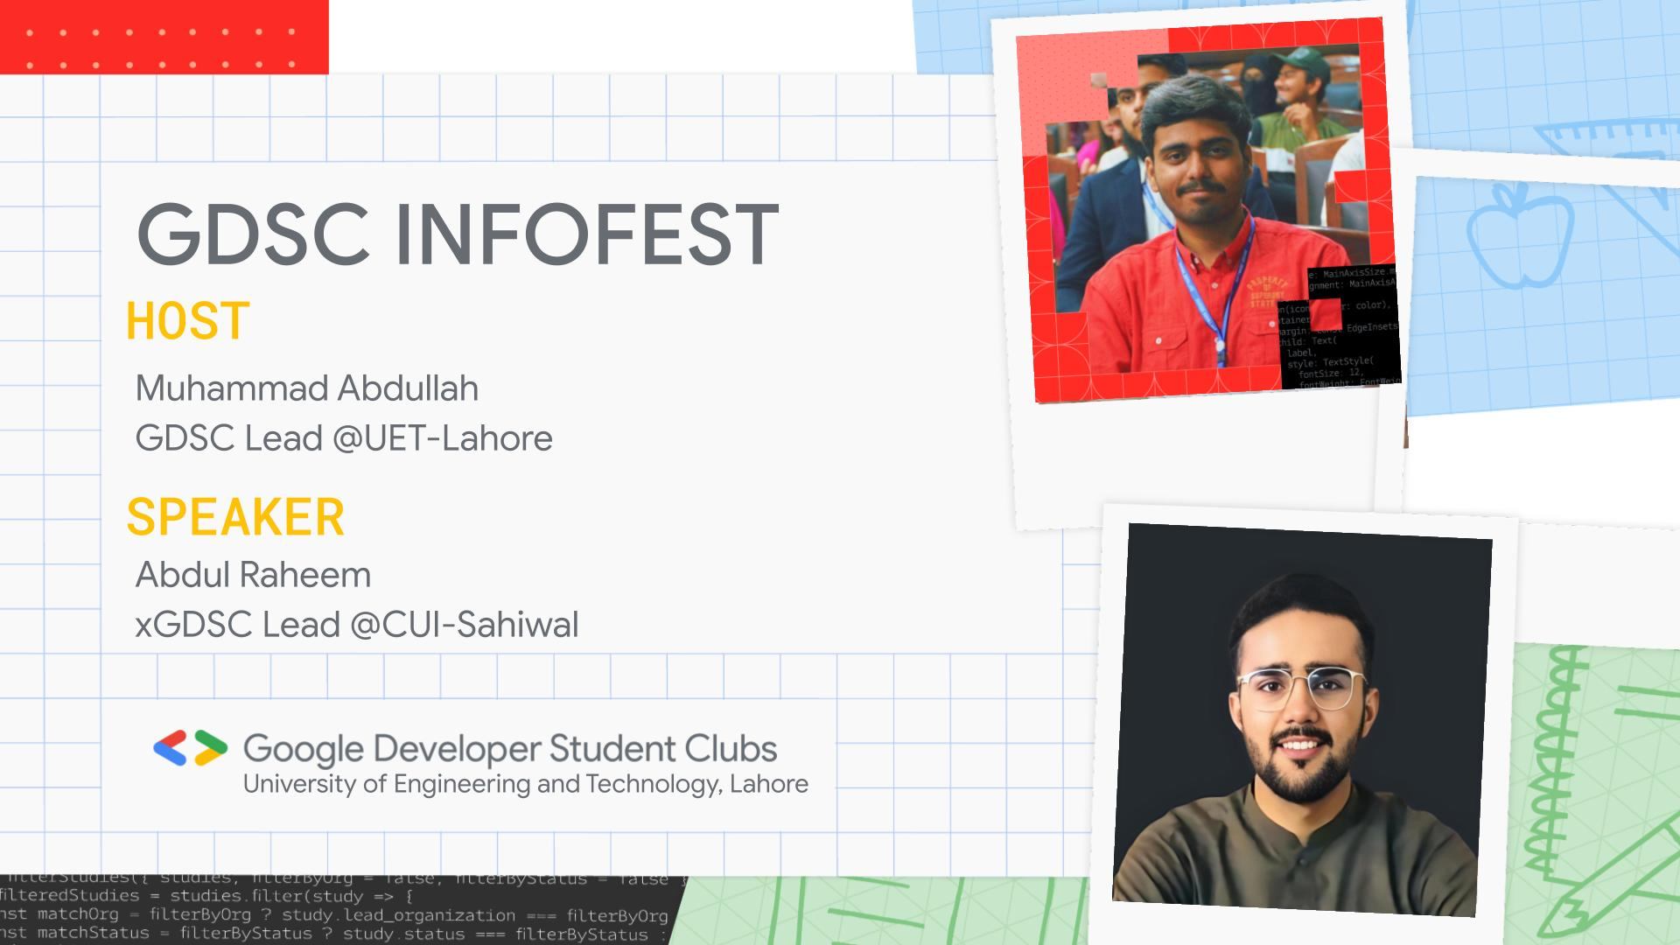

Slide 4
Agenda:
What is GDSC?
Our Vision and Mission
Meet the Team
Membership Benefits
Activities and Events
How to Get Involved
Q&A

Slide 5
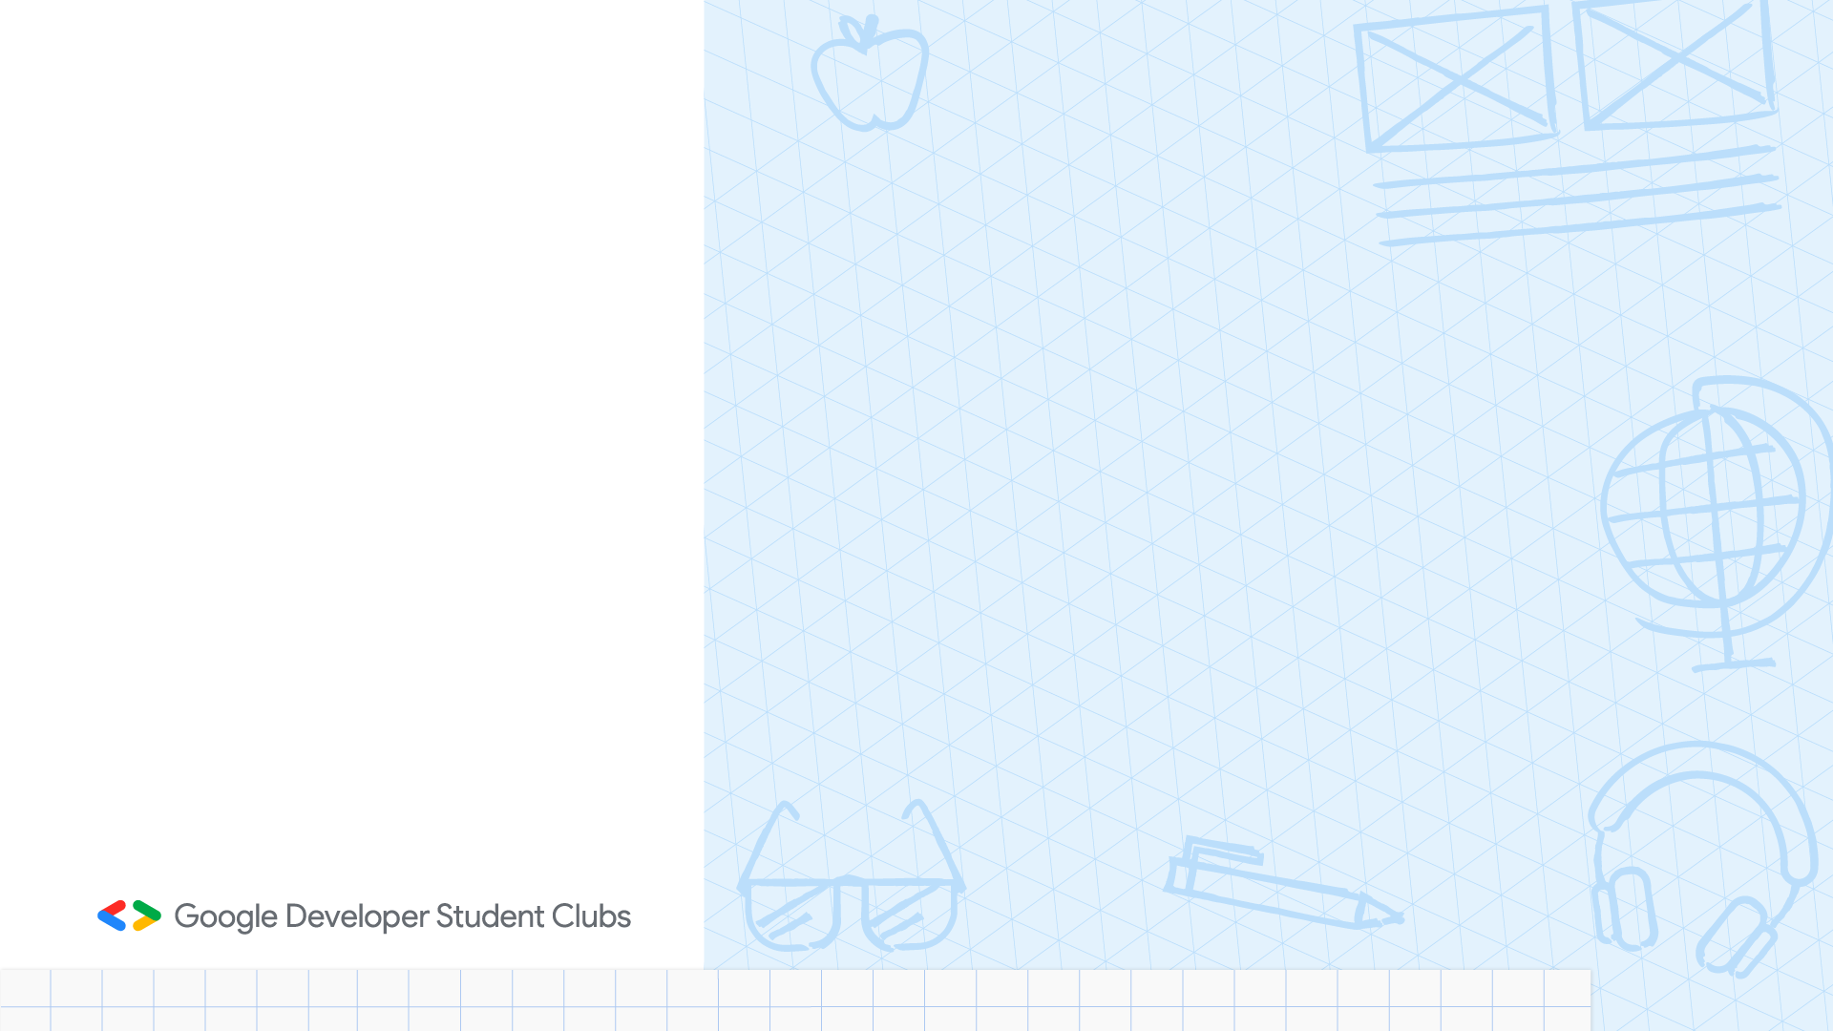
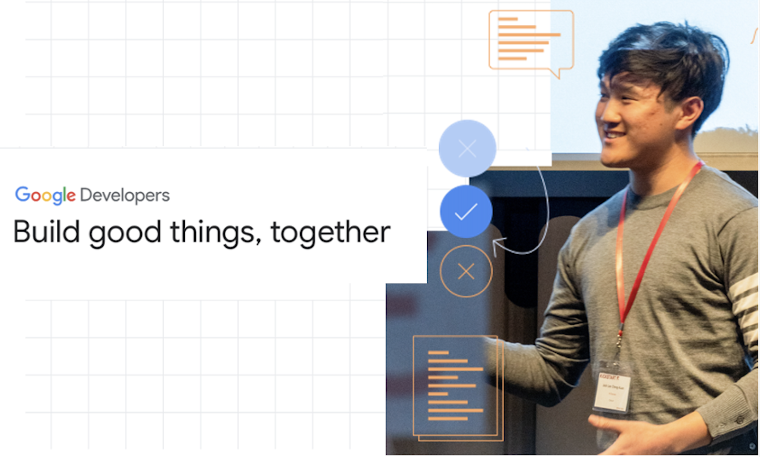
What is a Google Developer Student Clubs?

Slide 6

















What is GDSC?
Google Developer Student Clubs (GDSC) are community groups for college and university students interested in Google developer technologies. Students from all undergraduate or graduate programs with an interest in growing as a developer are welcome. By joining a GDSC, students grow their knowledge in a peer-to-peer learning environment and build solutions for local businesses and their community.

Slide 7



4 Main Communities

Slide 8
Mission & Vision
Vision Statement: To foster a culture of innovation and collaboration, shaping the future of technology.
Mission Statement: To provide students with the resources, knowledge, and networks to excel in the tech industry.

Slide 9
















What do we do in GDSC?

Slide 10













Discuss a wide range of technical topics. Assist students gain new skills through hands-on workshops. Provide in-person training and project building activities. Foster connections between students from diverse backgrounds and different areas of study. Help each other to learn and grow. Use our knowledge to solve local problems.

Slide 11
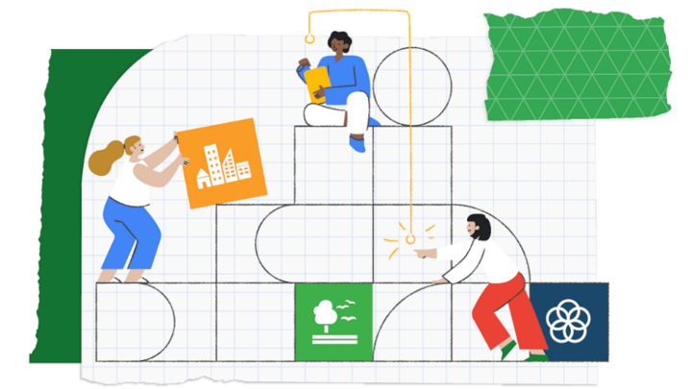
Google Solution Challenge

Slide 12
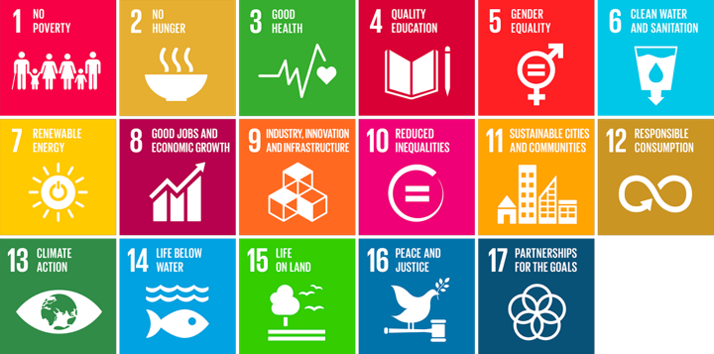
Objective
Solve real-world problems
Use Google technologies
Eligibility
Open to university students
Worldwide participation

Slide 13
Prizes
Cash rewards
Google hardware
Swag and certificates
Key Dates
Announced in Jan-Feb
Submission deadline: April
Winners revealed: June

Slide 14
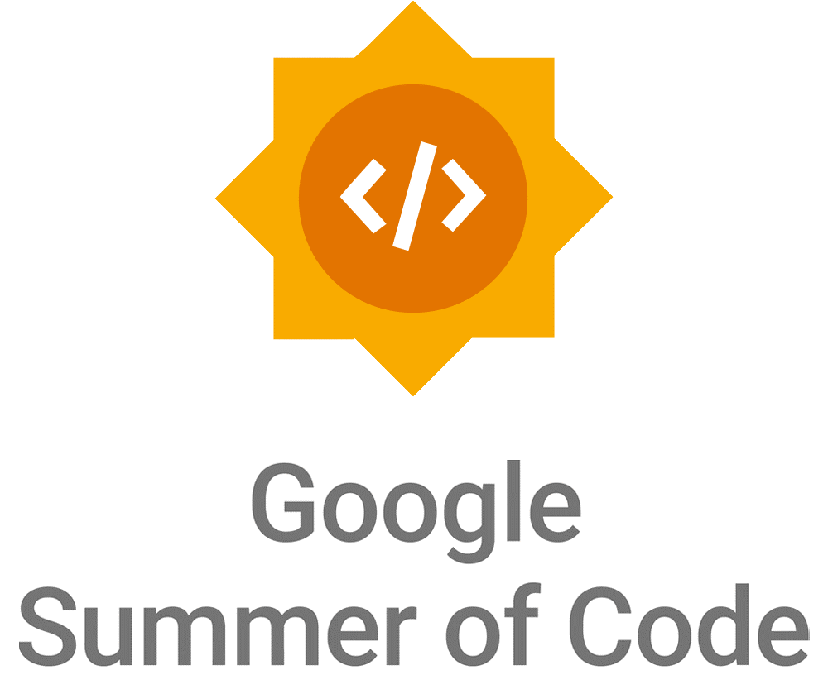
Google Summer of Code (GSoC)

Slide 15
Purpose
Foster student involvement
Improve open-source software
Selection
Propose project ideas
Organizations choose students
Competitive process

Slide 16
Community
Join a global network
Collaborate with experts
Build a strong portfolio
Key Dates
Application period: Jan-Feb
Coding phase: May-Aug
Results announced: Sep

Slide 17
More Events Coming Up

Slide 18
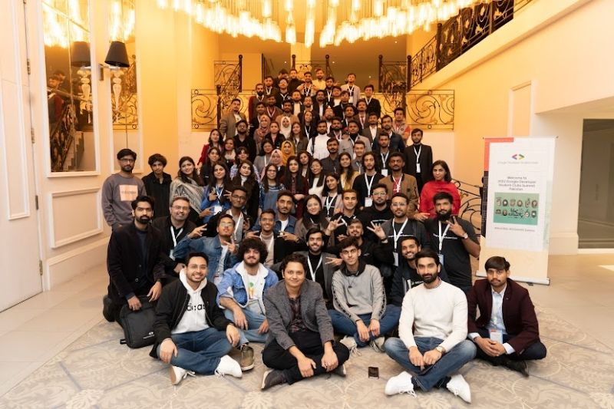

Slide 19
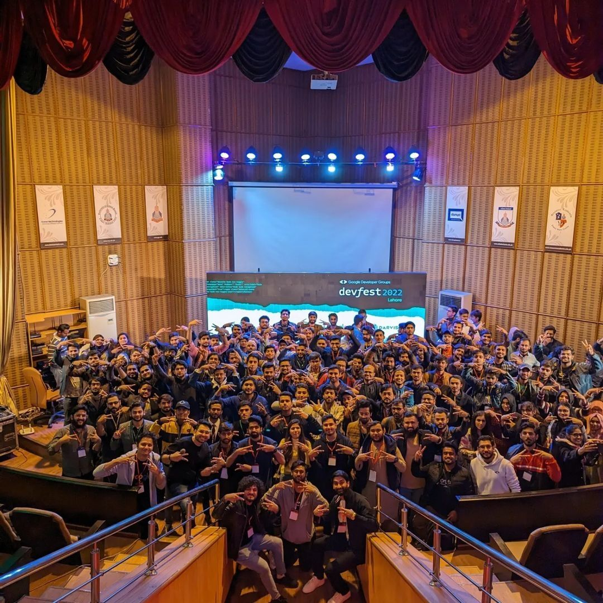
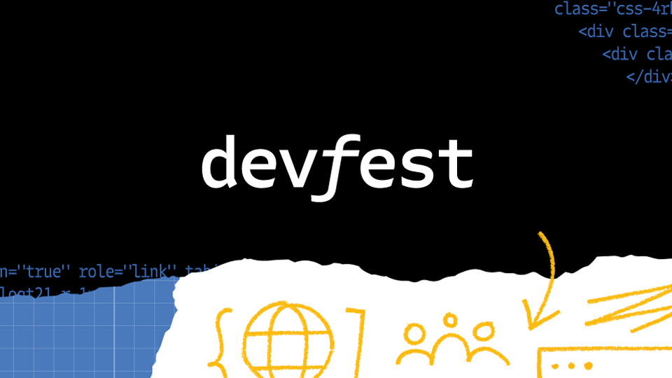

Slide 20


Slide 21
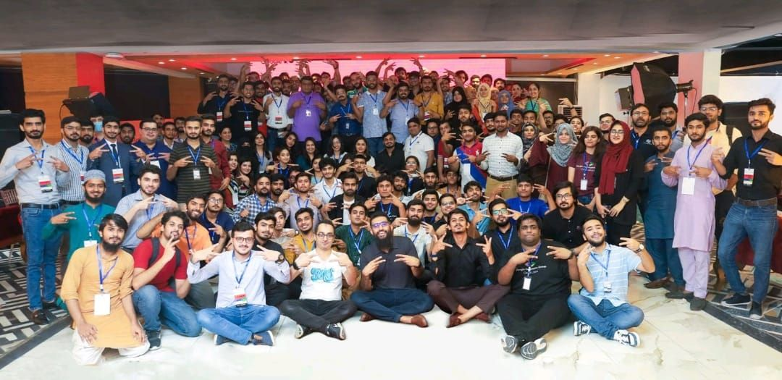

Slide 22
GDSC UET-Lahore

Slide 23
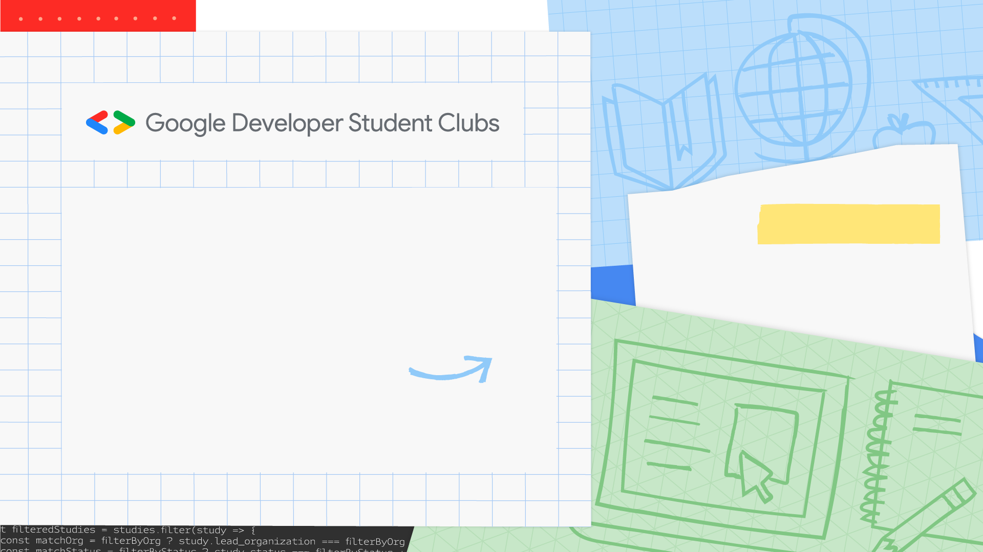
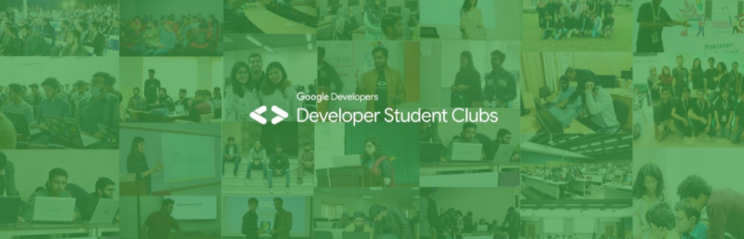
Started in 2019 5th Batch 81 Leads

Slide 24

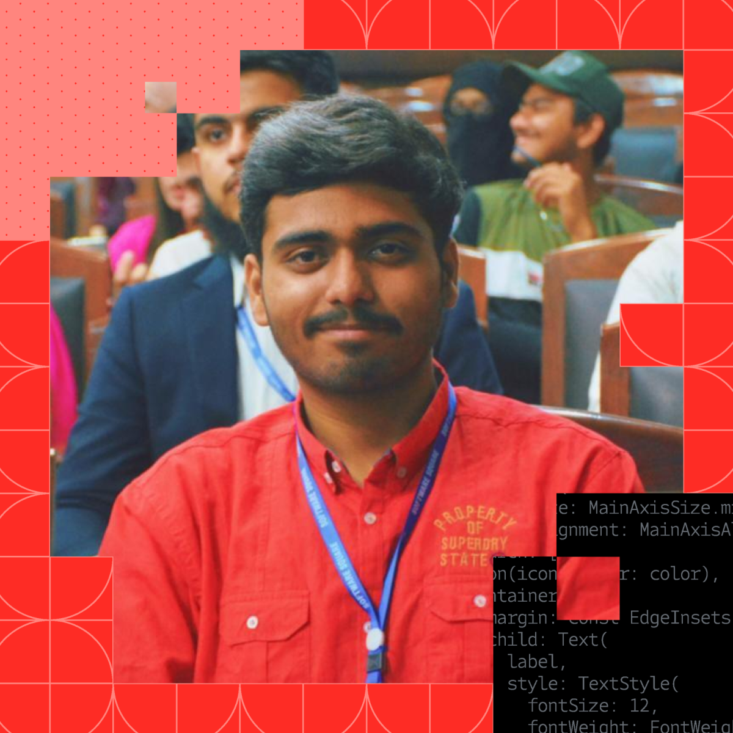
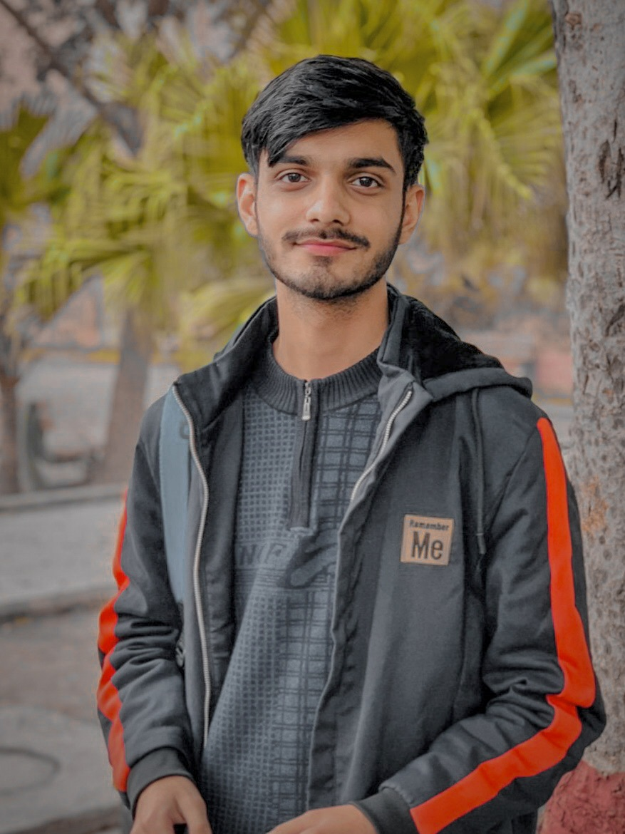
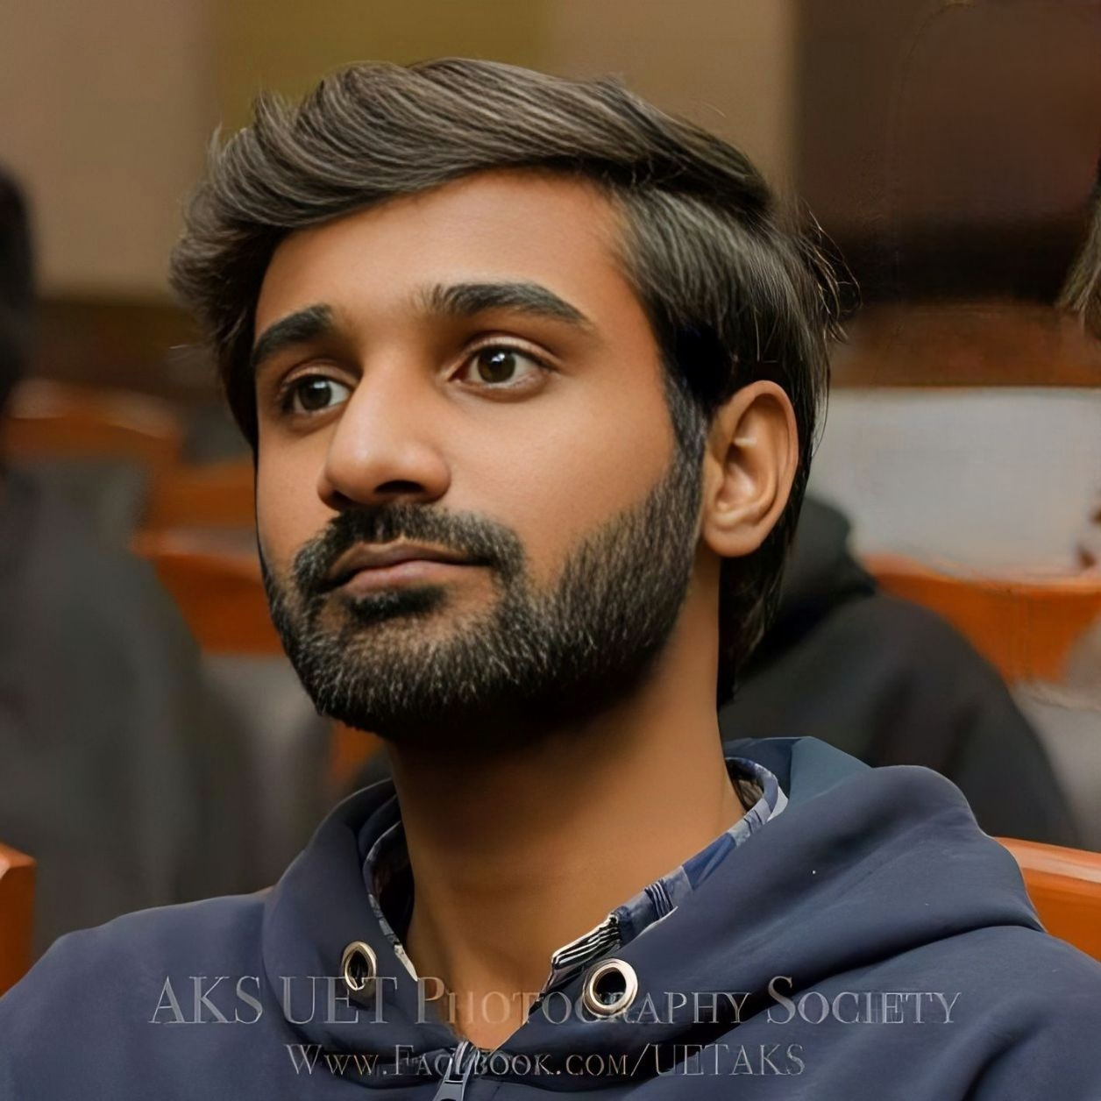
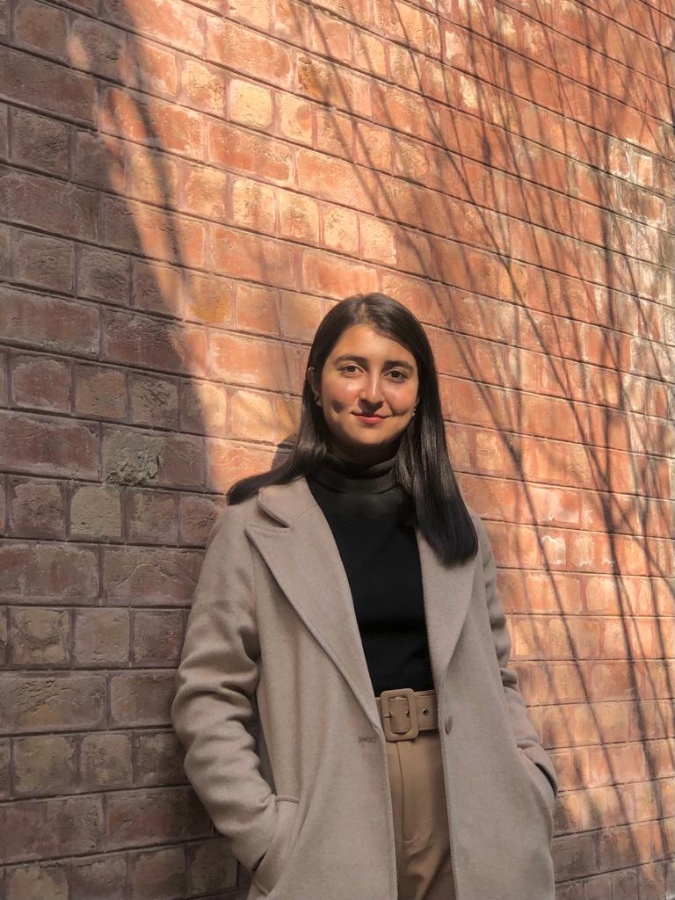
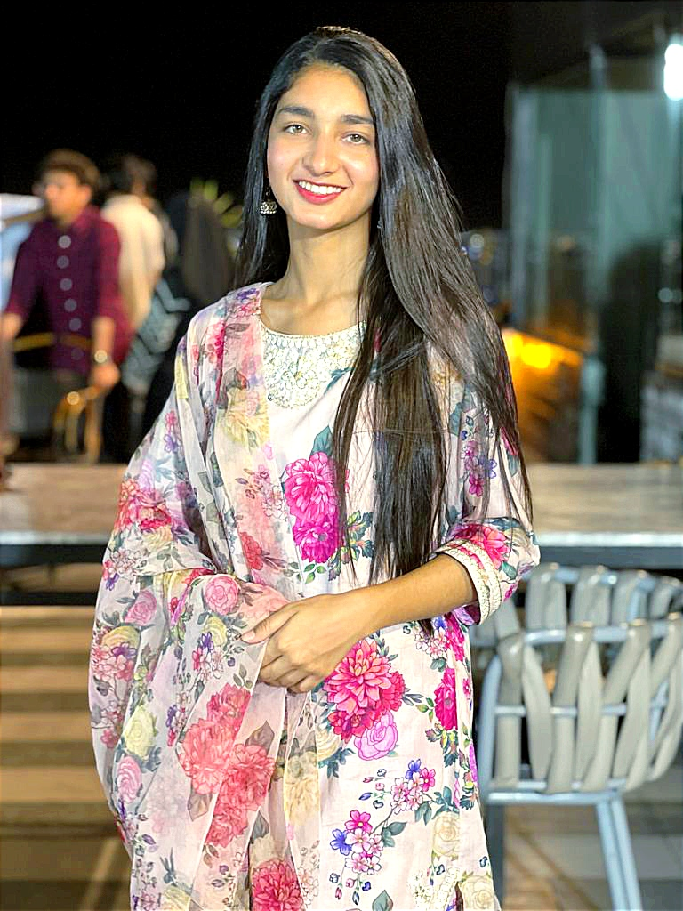
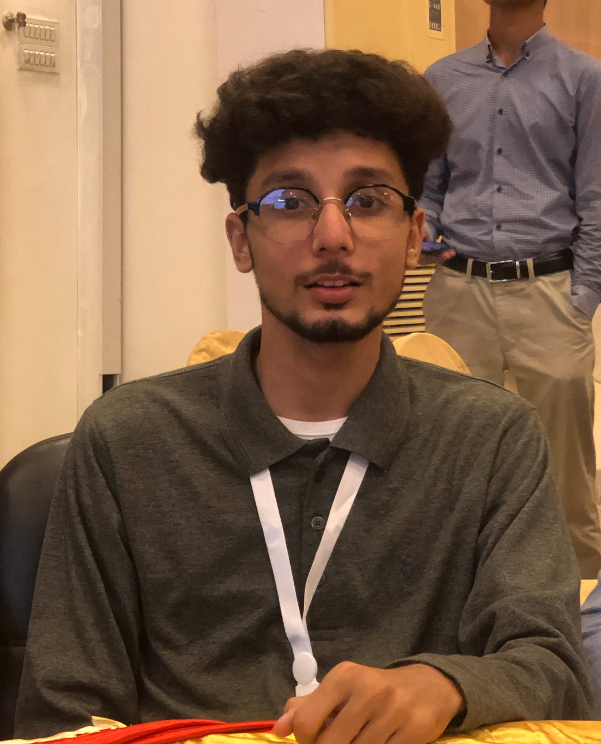
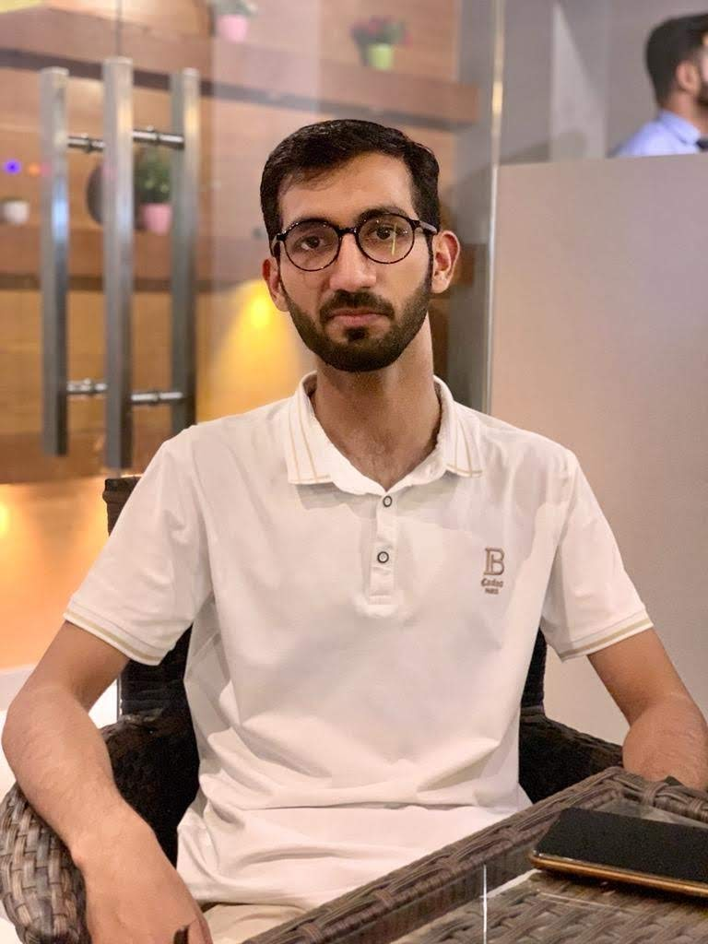
Our Team
Muhammad Abdullah
Campus Lead
Syed Abdul Rehman
Technical Lead
Syed Noor Ali
Management Lead
Zoya Naveed
Creative Lead
Anam Shahzad
OutReach Lead
Hammad Ejaz
Development Lead
Muhammad Wali Ahmad
Social Media Lead

Slide 25
TechTitans
Syed Abdul Rehman
Technical Team Lead
SubTeams
CyberSecurity
AI/ML
Cloud
Data Science
Blockchain

Slide 26
Syed Noor Ali
Management Team Lead
TheExecutioners
SubTeams
Workshops
Event Management
Hosting

Slide 27
Zoya Naveed
Creative Team Lead
ArtistryAssemblage
SubTeams
Graphics Design
Ideas
Photography
Videography

Slide 28
Anam Shahzad
Outreach Lead
ReachRally
SubTeams
PR
Sponsorships

Slide 29
Hammad Ejaz
Development Lead
DevCorps
SubTeams
Web Development
Flutter
Desktop Development

Slide 30
Muhammad Wali Ahmad
Social Media Lead
CommunityCatalysts
SubTeams
Documentation
Marketing
Registration
Memers

Slide 31
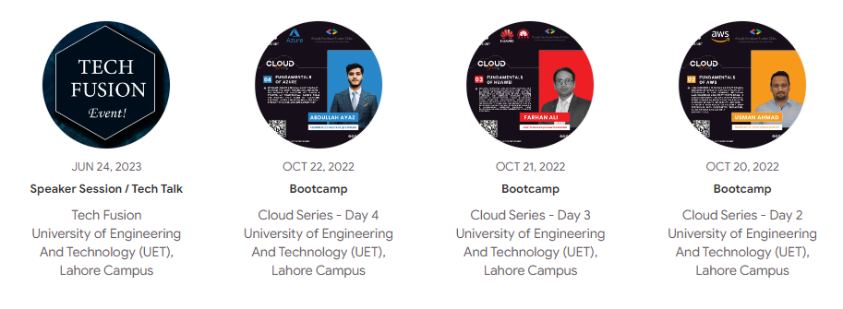
Our Previous Events

Slide 32
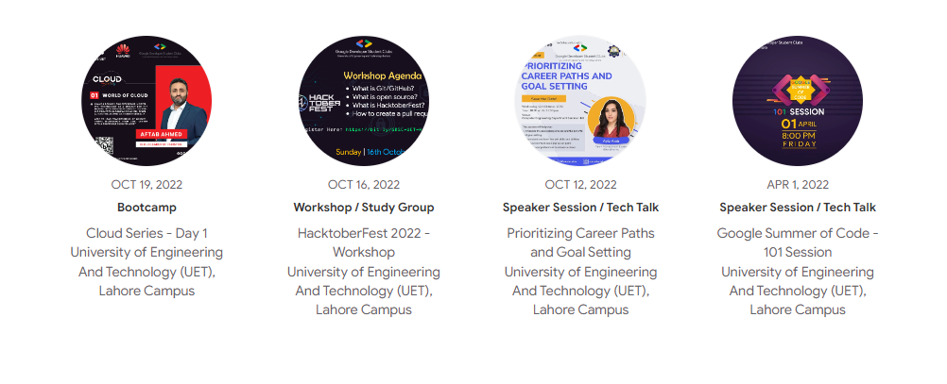
Our Previous Events

Slide 33
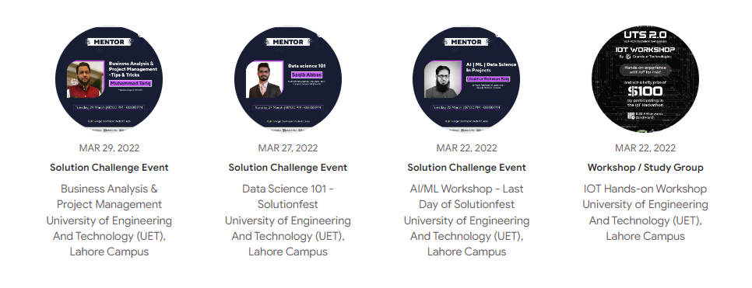
Our Previous Events

Slide 34
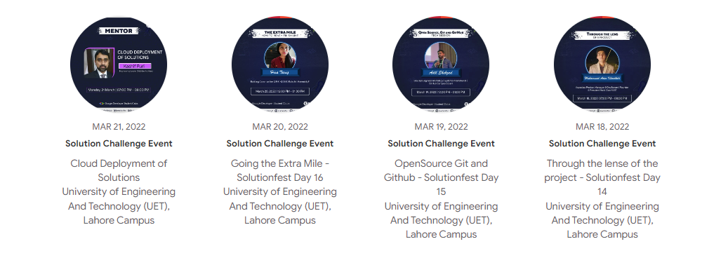
Our Previous Events

Slide 35
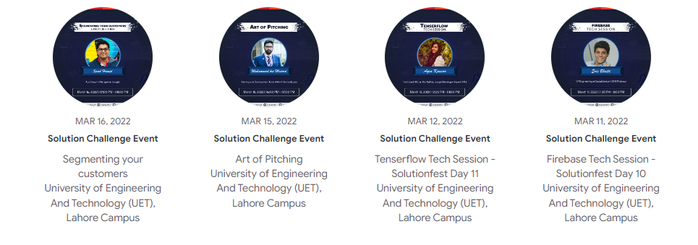
Our Previous Events

Slide 36
Benefits of Joining us
Networking Opportunities
Skill Development
Access to Resources and Mentors
Project Collaboration
Certifications and Recognition
Swags and Certificates

Slide 37
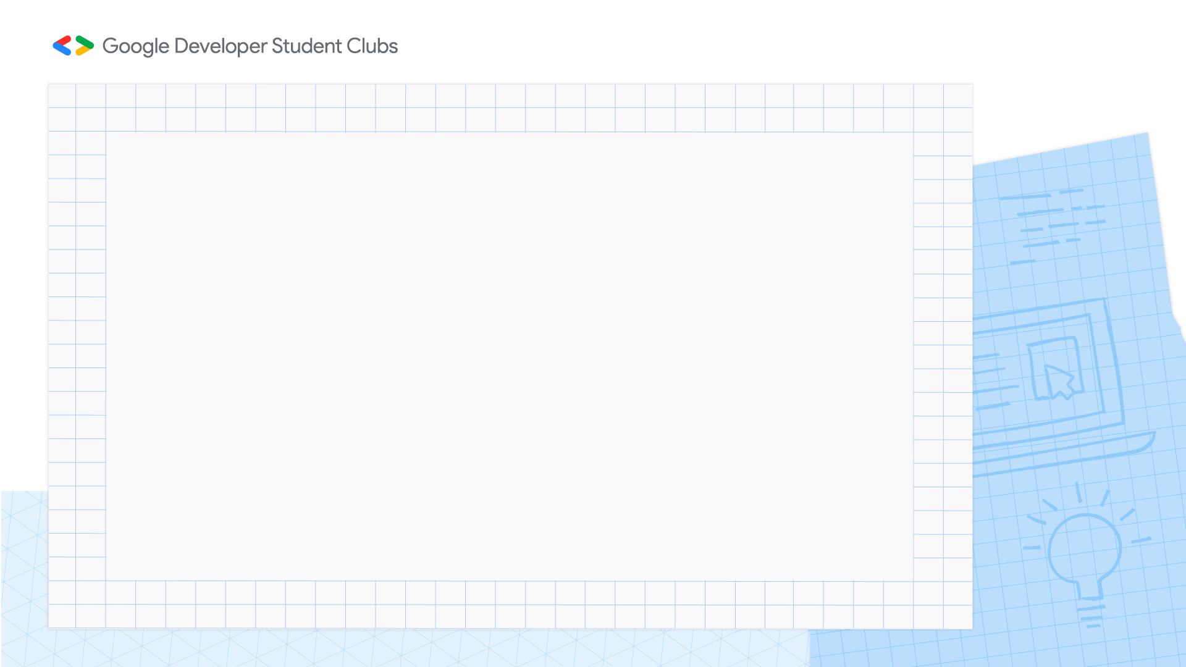
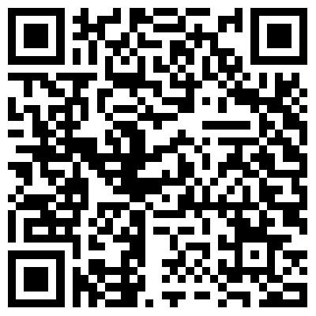
Core Team Inductions

Slide 38
Social Media
https://www.linkedin.com/company/gdscuet/
https://www.facebook.com/dscuet
https://www.instagram.com/dscuet/?hl=en
https://twitter.com/dscuet

Slide 39
Now its Your Time
QnA

Slide 40

Thank You

